Slide 1

Course: BSc CSIT Madan Bhandari Memorial College Geographic Information System
Concept and Content
CSC482 Unit-1 Class 1
Dfw' ;'bg clwsf/L

Slide 2
Agenda
Concept
Spatial/Geographic/Geographical
Fact, data, Information
System
Input, process, output
Content
Course Description
Course Objective
Course Contents

Slide 3
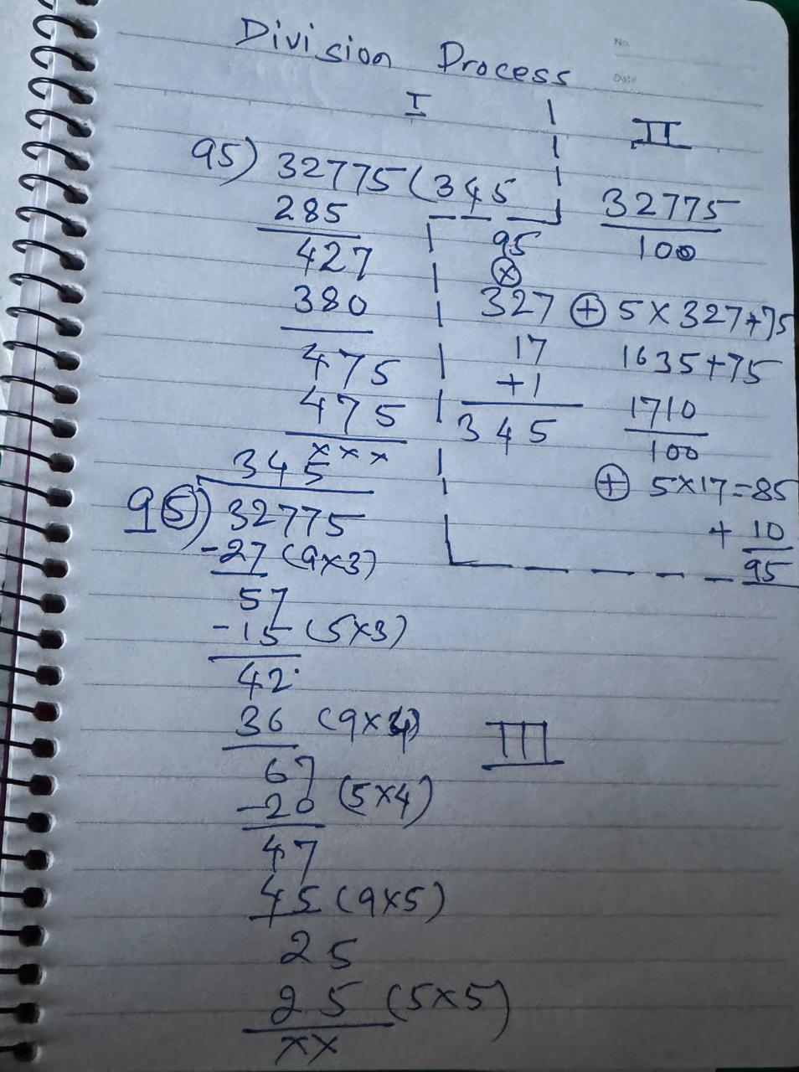
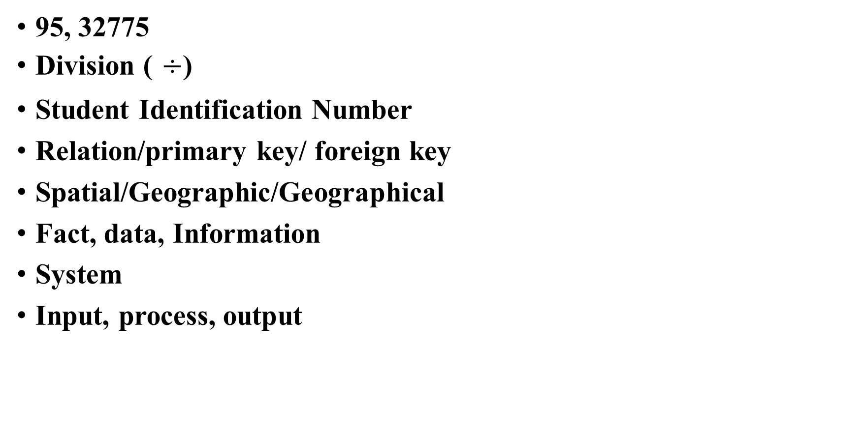
Concept
95, 32775
Division ( $÷$)
Student Identification Number
Relation/primary key/ foreign key
Spatial/Geographic/Geographical
Fact, data, Information
System
Input, process, output

Slide 4
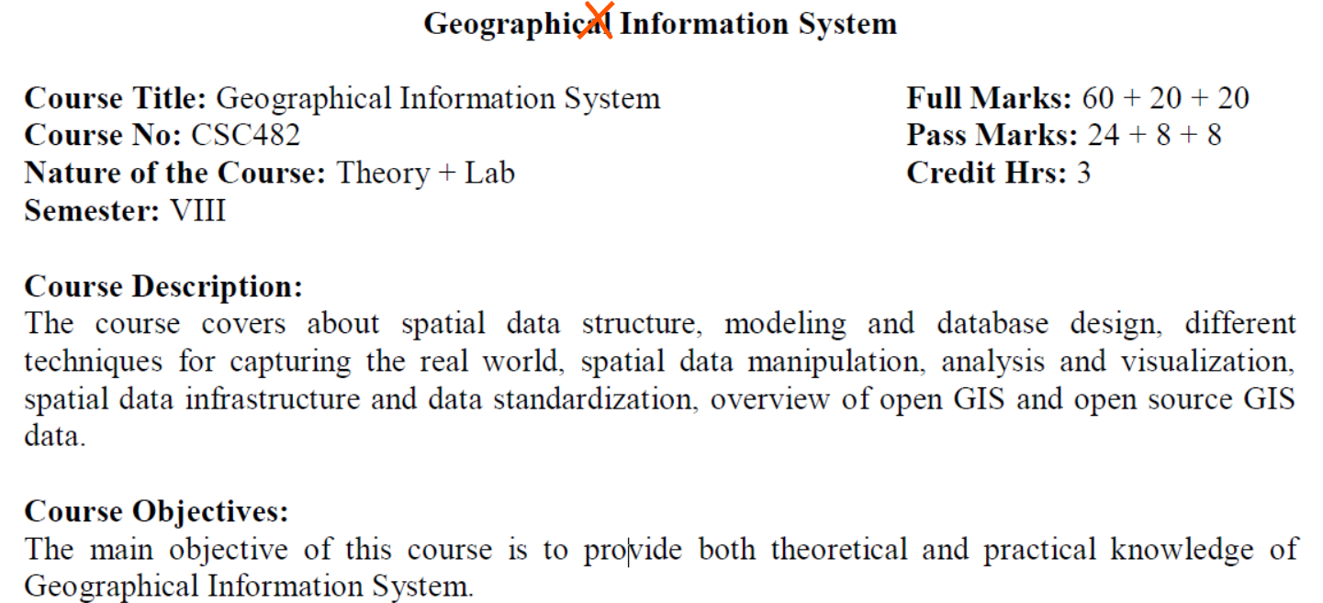
Content

Slide 5
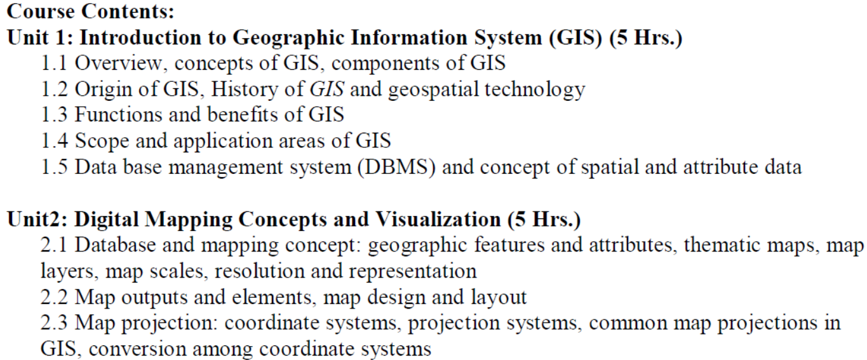
Content

Slide 6
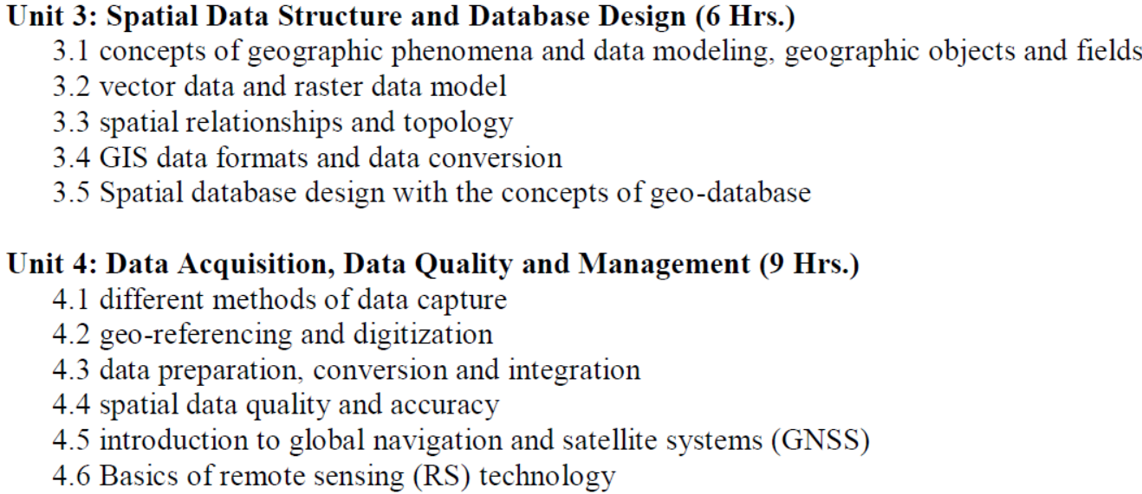
Content

Slide 7
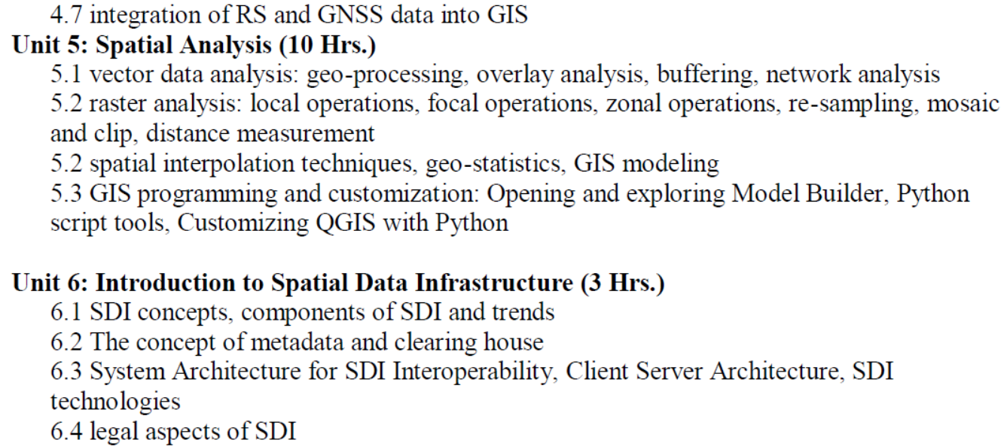
Content

Slide 8
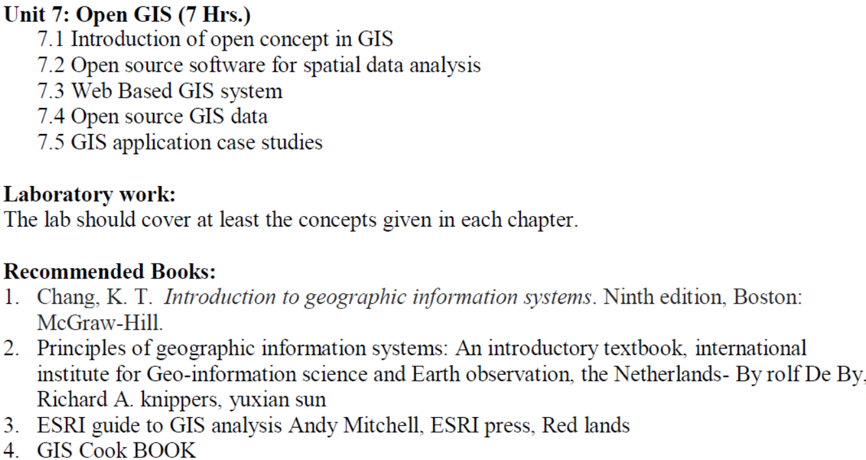
Content

Slide 9
Thank You

